Slide 1
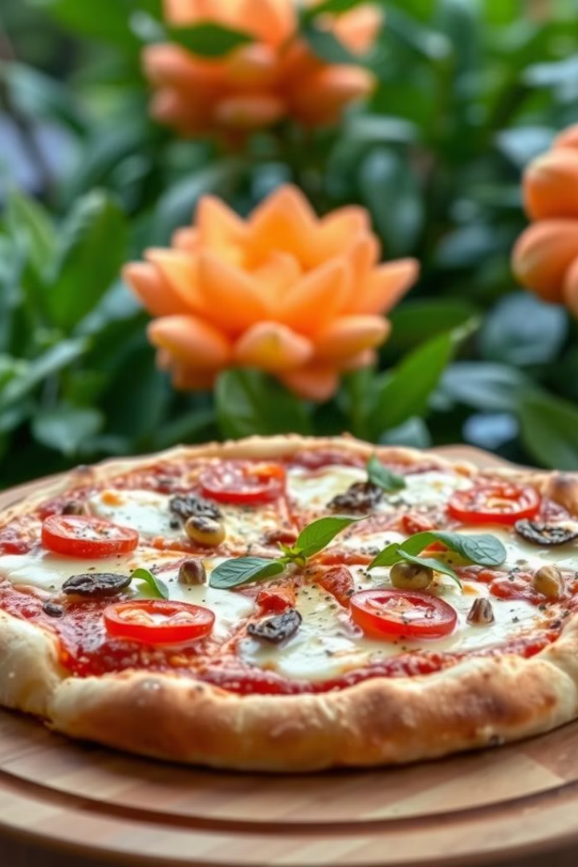
Food Delivery Website: [Pizza]

Slide 2
Developed by Piyush Kumar Mishra
Website Developer
Piyush Kumar Mishra designed and developed this website.

Slide 3
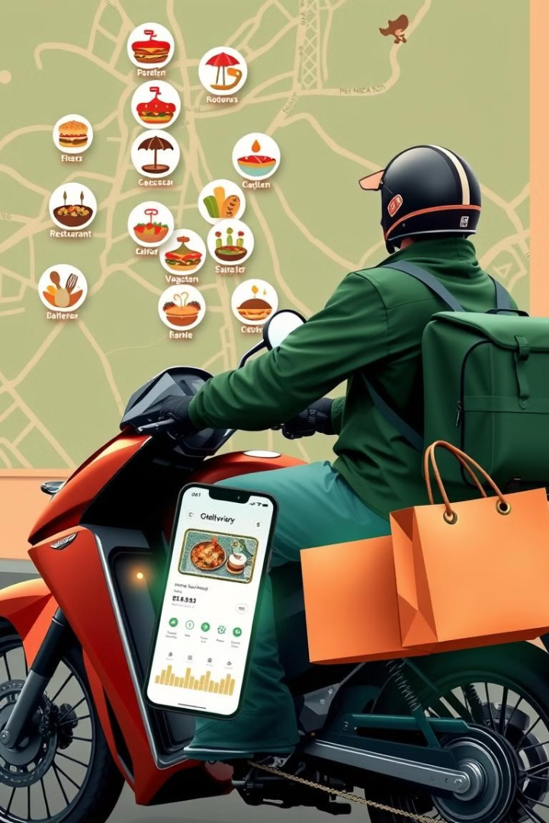
Purpose of the Website
Efficiency
Convenience
The website makes ordering food fast and convenient for users.
Users can browse menus and order food from their homes or offices.

Slide 4
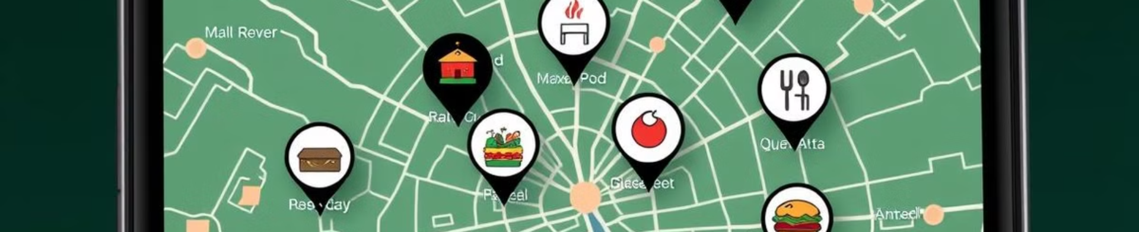



Browse Restaurants
Browse By Location
Search by Cuisine
Filter Options
Users can browse restaurants near them.
Users can search for restaurants by cuisine.
Users can filter restaurants by price, rating, or other criteria.

Slide 5
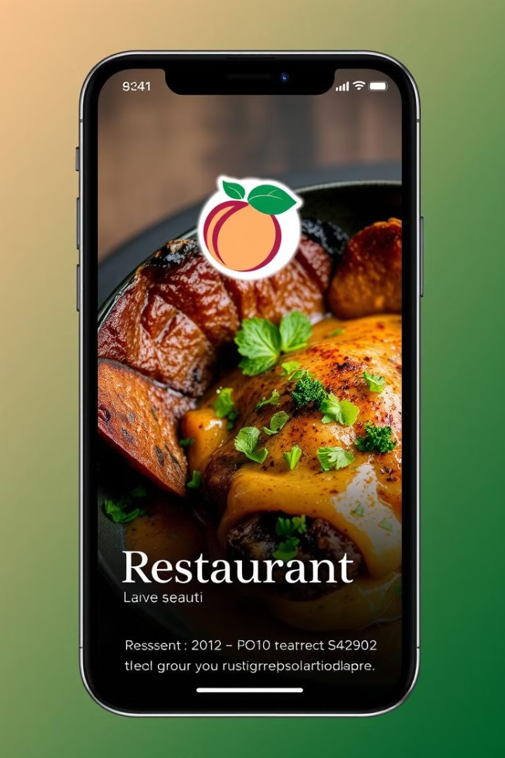
View Menu
1
Menu Items
View all menu items with descriptions and photos.
2
Pricing
See the price of each item.
3
Add to Cart
Add items to cart for easy ordering.

Slide 6
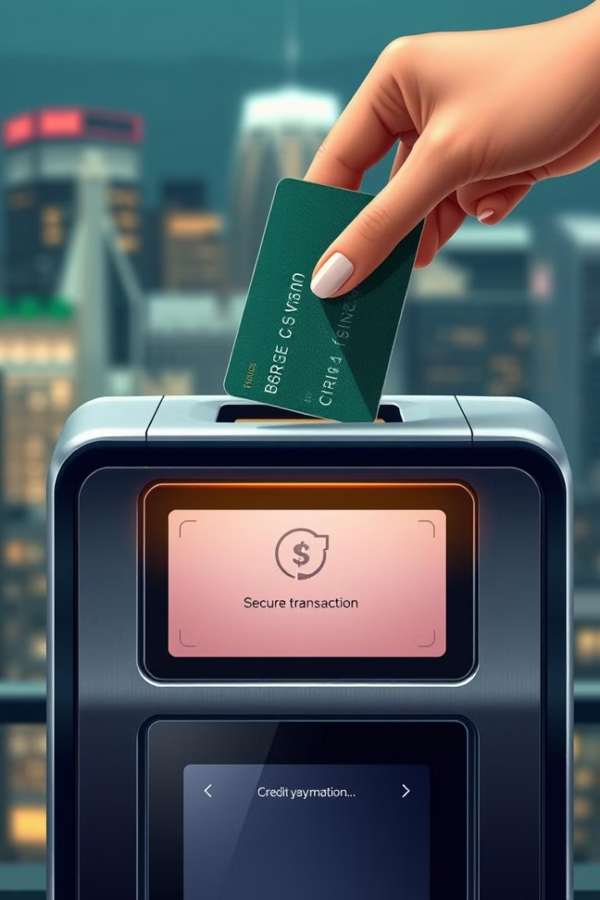

Payment Details
Secure Payment
Use a secure payment gateway to protect user data.

Slide 7



Order Tracking
Real-time Tracking
1
Track the progress of the order on a map.
Order Status
2
Receive updates on the status of the order.
Estimated Delivery Time
3
View an estimated delivery time.

Slide 8
Thank You
1
Feedback
We value your feedback. Please share your thoughts on your experience with our website.

